Slide 1
Data Communication
Data Communication is the exchange of information from one entity to the other using a Transmission Medium.
‹#›

Slide 2
Data Communication
1883: Samuel Morse & Alfred Veil invent Morse Code Telegraph System
1876: Alexander Graham Bell invented Telephone
1930: Development of ASCII Transmission Code
1950: IBM releases its first computer IBM 710
1960: IBM releases the First Commercial Computer IBM 360
‹#›

Slide 3
Data Communication Definition (Modified)
Data Communication is the exchange of data (in the form of 0’s and 1’s) between two devices (computers) via some form of the transmission medium.
‹#›

Slide 4
DATA COMMUNICATIONs
The term telecommunication means communication at a distance. The word data refers to information presented in whatever form is agreed upon by the parties creating and using the data. Data communications are the exchange of data between two devices via some form of transmission medium such as a wire cable.
1.‹#›

Slide 5



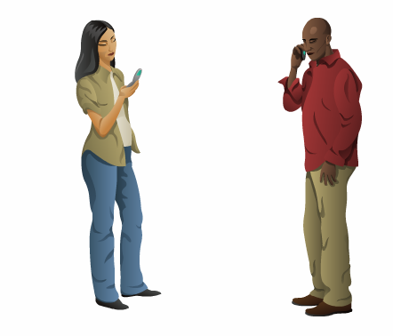
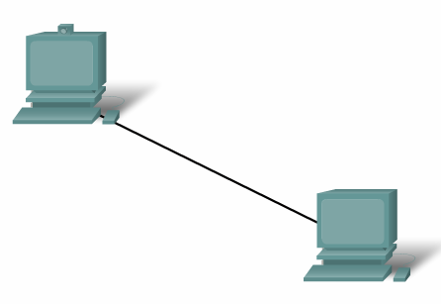

Elements of Communication
‹#›

Slide 6
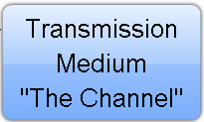




Elements of Communication
What are the elements?
‹#›

Slide 7
Elements of Communication over Networks
Devices (Sender/Receiver)
These are used to communicate with one another
Medium
This is how the devices are connected together
Messages
Information that travels over the medium
Rules/Protocols
Governs how messages flow across network
‹#›

Slide 8
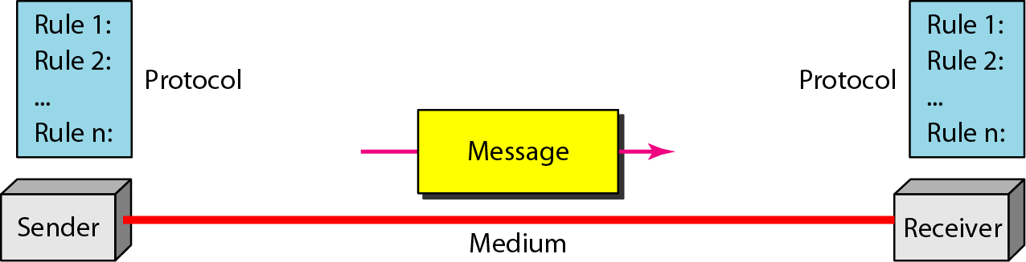
Five elements/components of data communication
1.‹#›

Slide 9
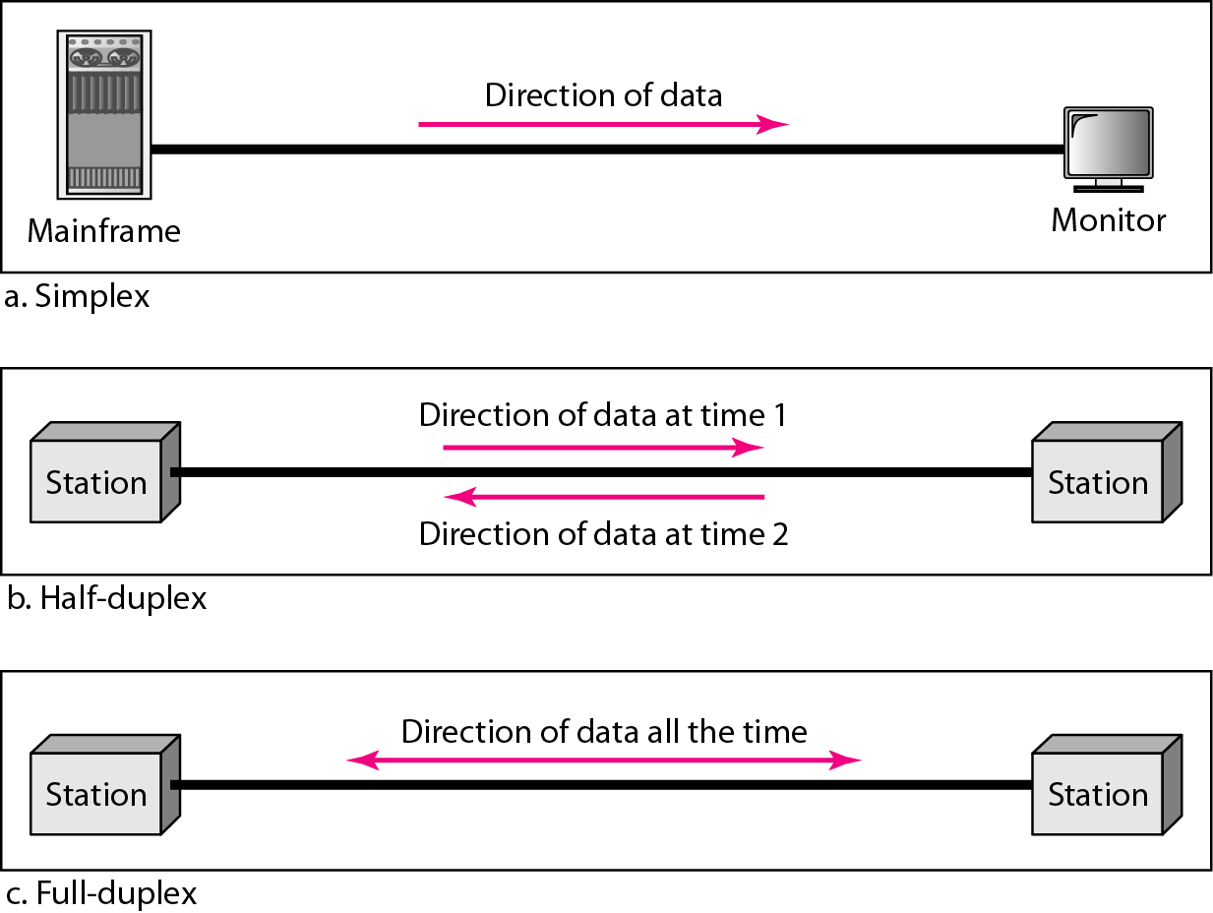
Data flow (simplex, half-duplex, and full-duplex)
1.‹#›

Slide 10
NETWORKS
A network is a set of devices (often referred to as nodes) connected by communication links. A node can be a computer, printer, or any other device capable of sending and/or receiving data generated by other nodes on the network.
Topics discussed in this section:
Distributed Processing Physical Structures Categories of Networks Interconnection of Networks: Internetwork

Slide 11
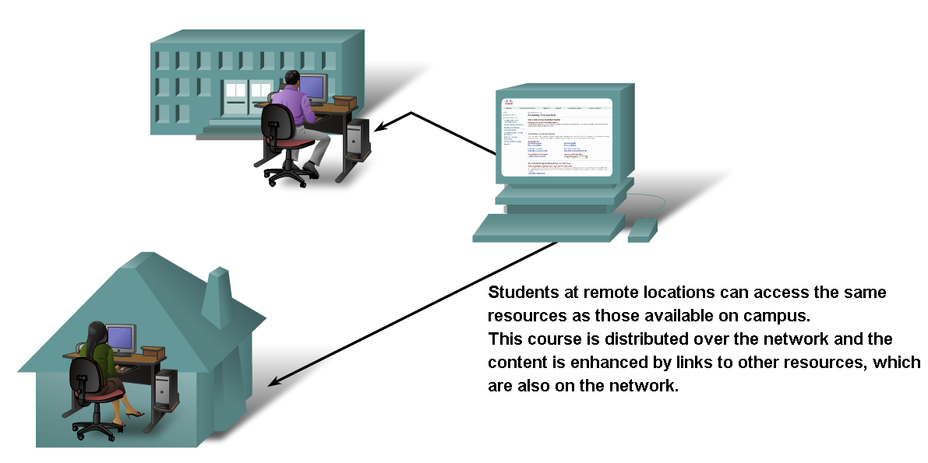
Networks supporting the way we learn.
‹#›

Slide 12


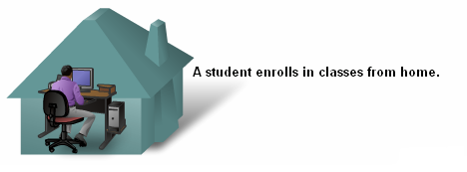

Networks supporting the way we learn.
‹#›

Slide 13
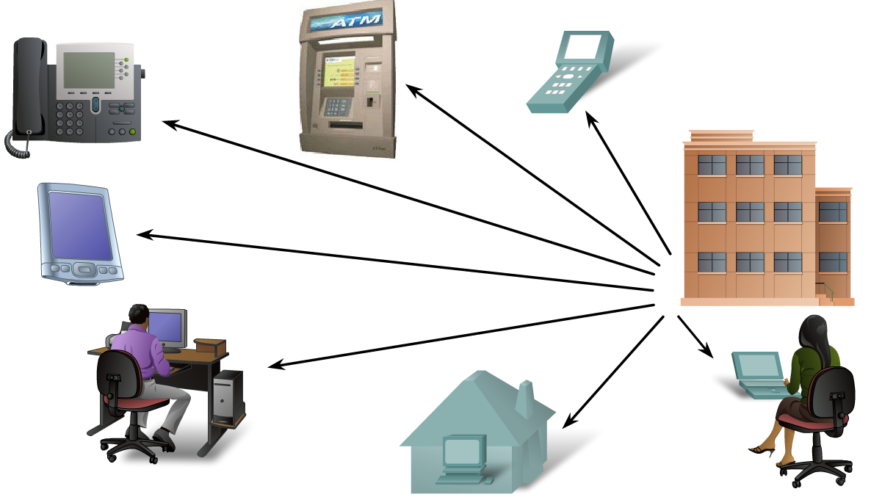
Networks supporting the way we work.
‹#›

Slide 14
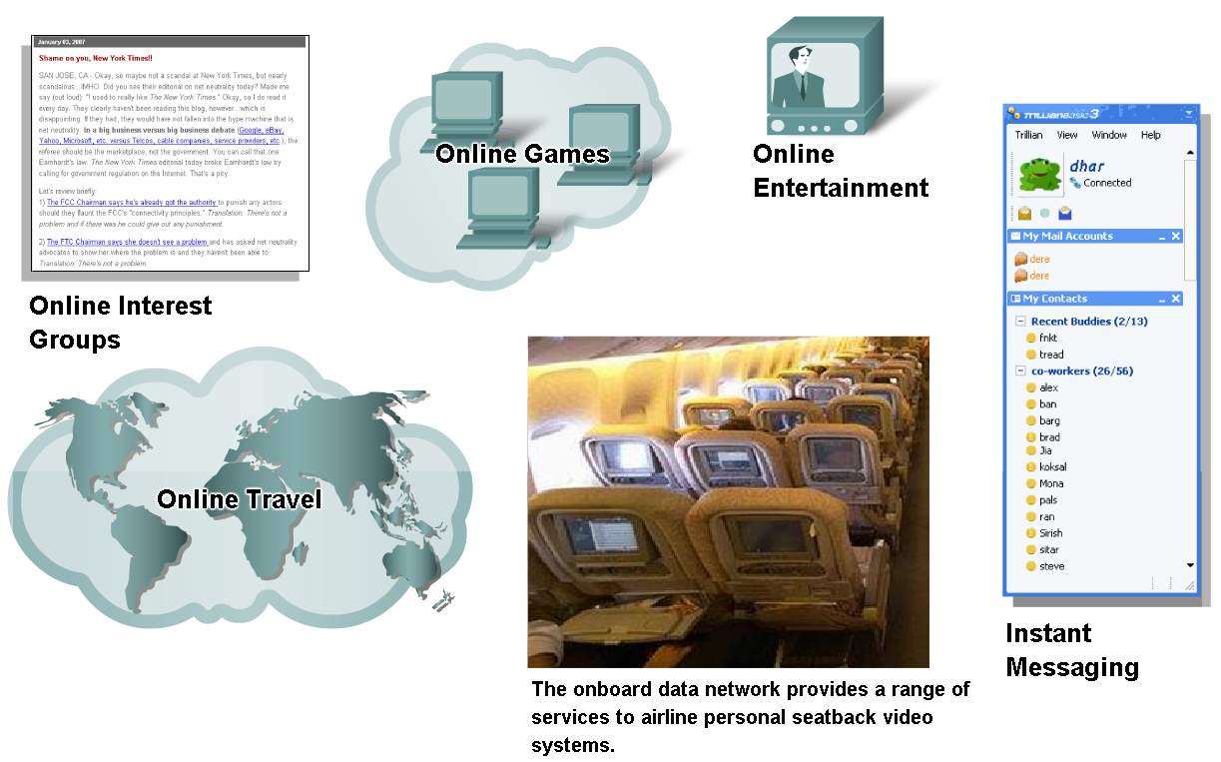
Networks supporting the way we play.
‹#›

Slide 15
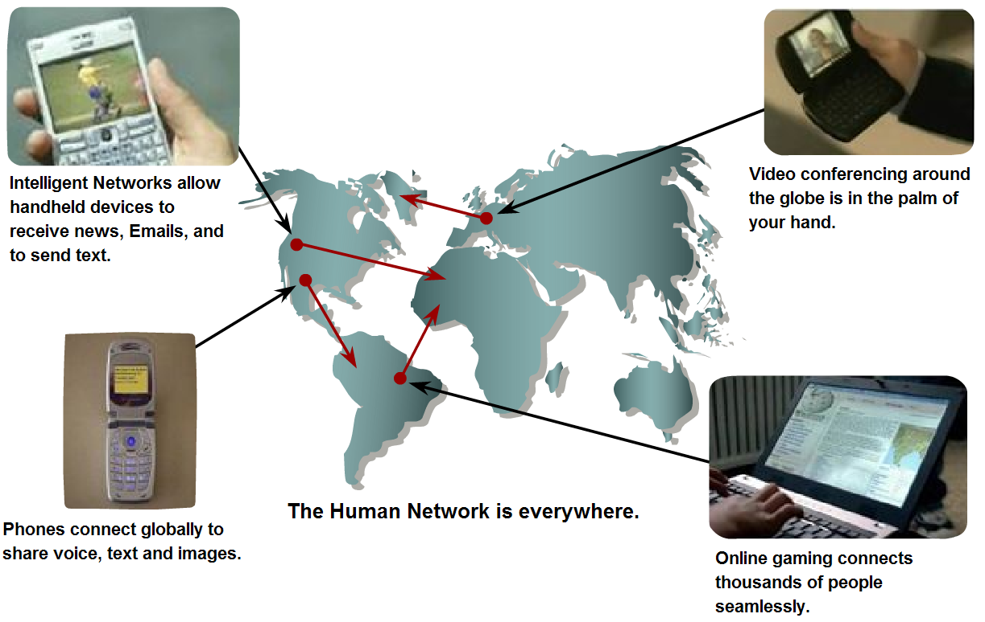
Networks- Purpose???
Communication.
‹#›

Slide 16
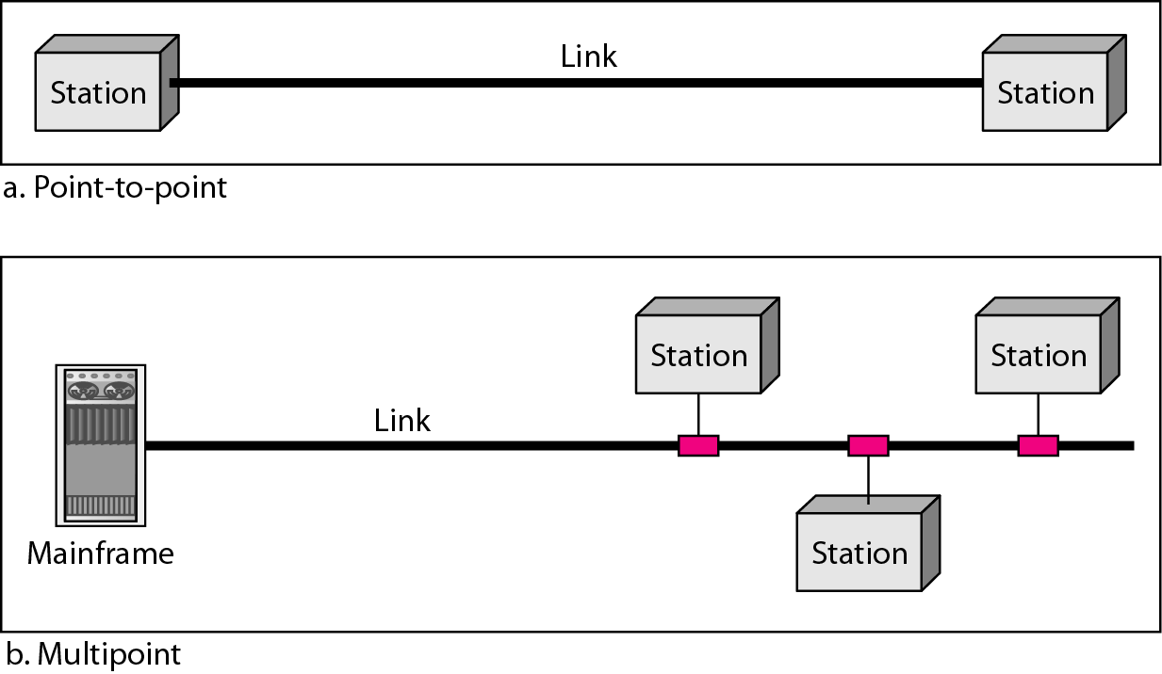
Figure 1.3 Types of connections: point-to-point and multipoint
1.‹#›

Slide 17
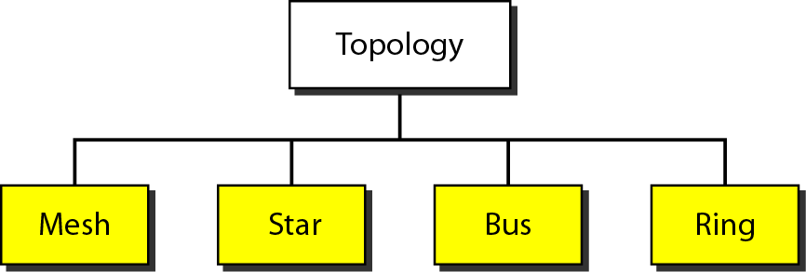
Figure 1.4 Categories of topology
1.‹#›

Slide 18
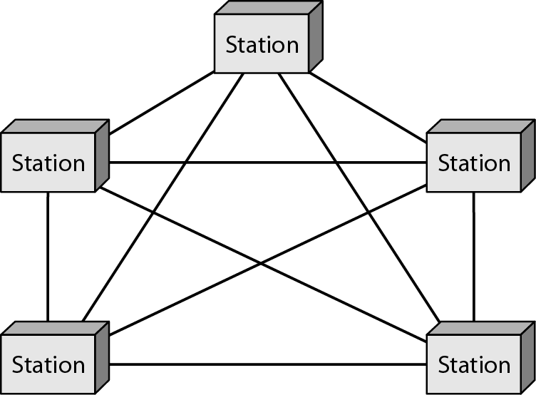
Figure 1.5 A fully connected mesh topology (five devices)
1.‹#›

Slide 19
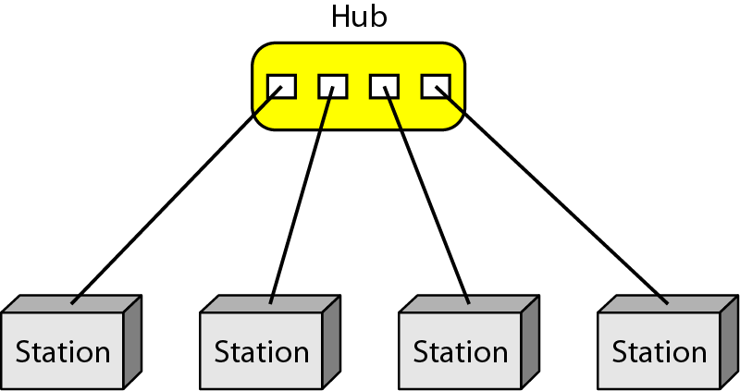
Figure 1.6 A star topology connecting four stations
1.‹#›

Slide 20
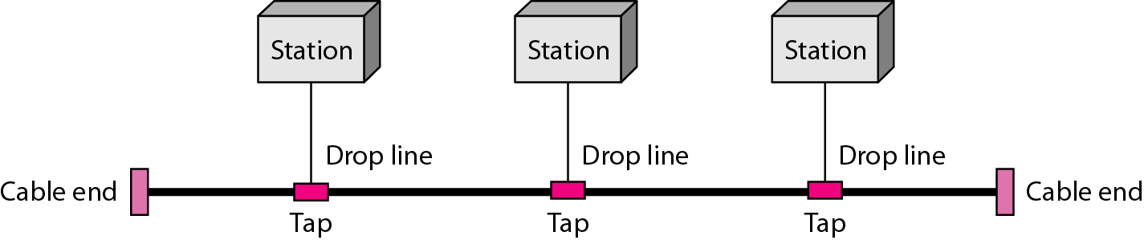
Figure 1.7 A bus topology connecting three stations
1.‹#›

Slide 21
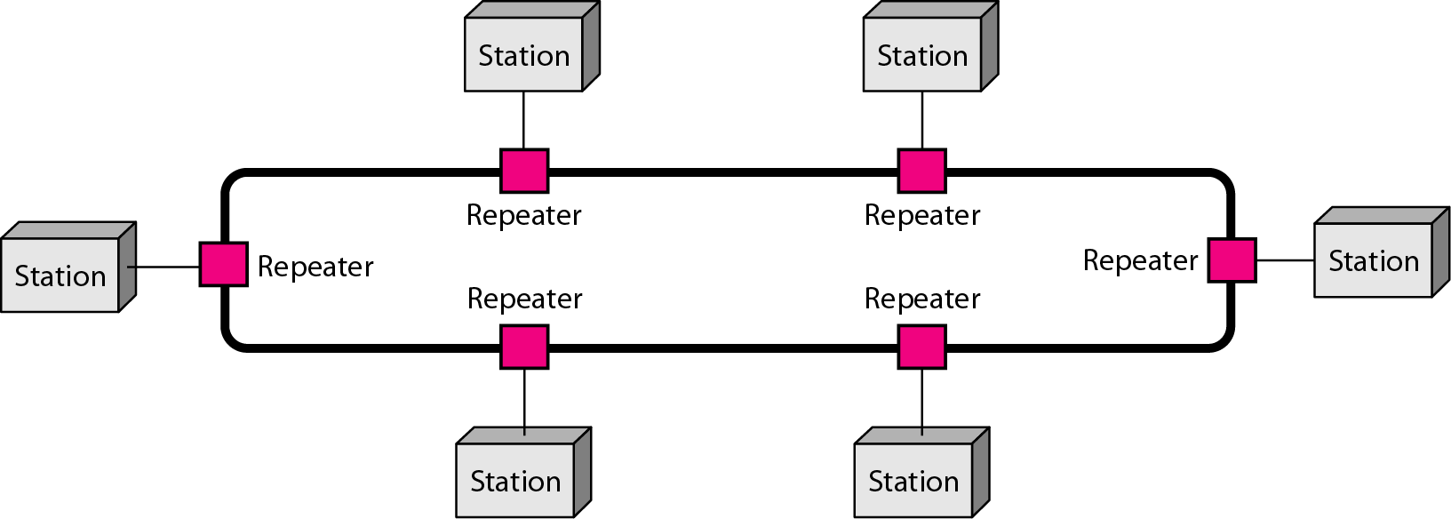
Figure 1.8 A ring topology connecting six stations
1.‹#›

Slide 22
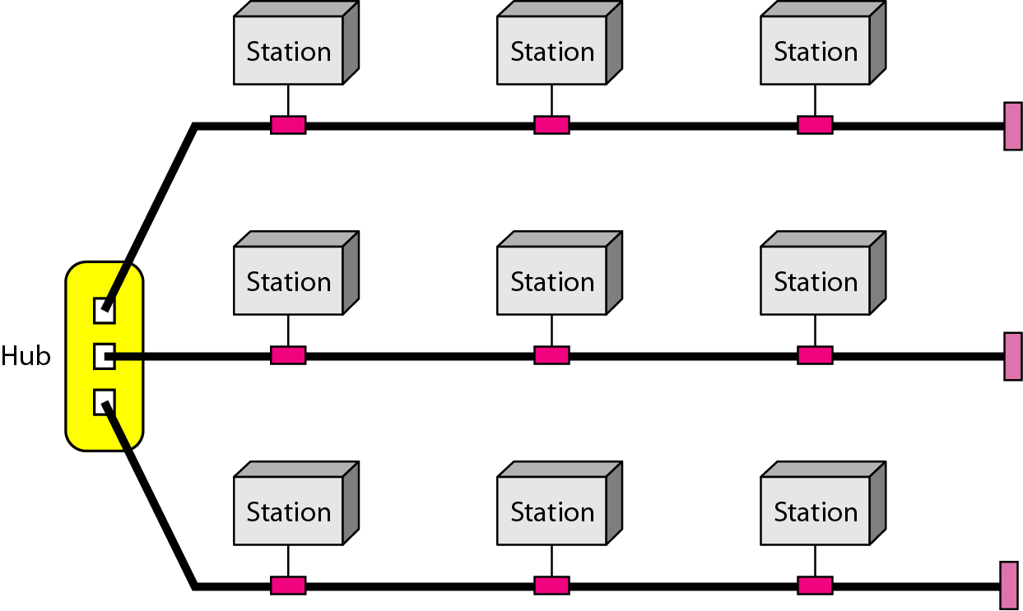
Figure 1.9 A hybrid topology: a star backbone with three bus networks
1.‹#›

Slide 23
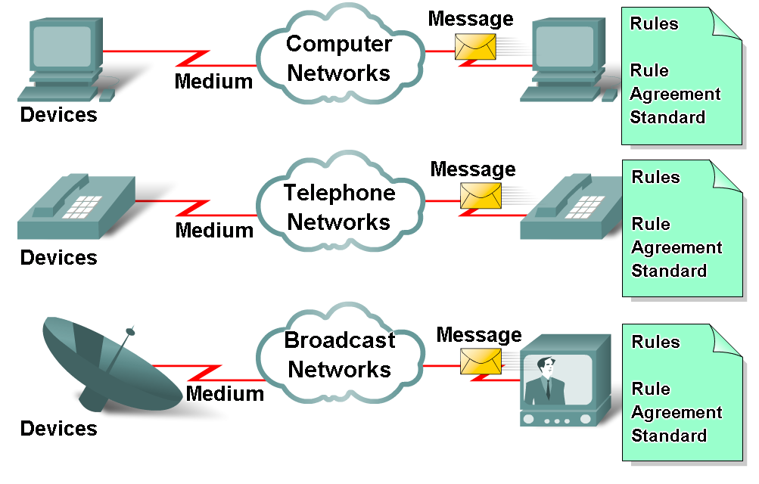
Elements of Communication over Networks
‹#›

Slide 24
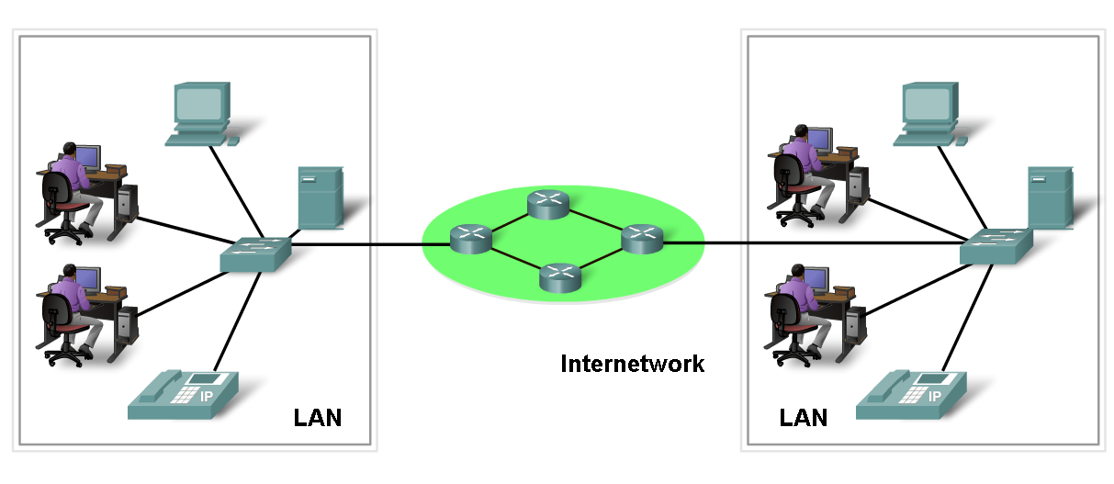
Network Elements/Components
Network Devices
Hardware (Devices and Media)
Software (Services and Processes)
‹#›

Slide 25
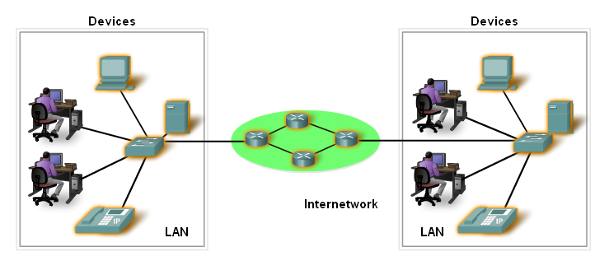
Devices
Two Types:
End Devices
Intermediary Devices
‹#›

Slide 26
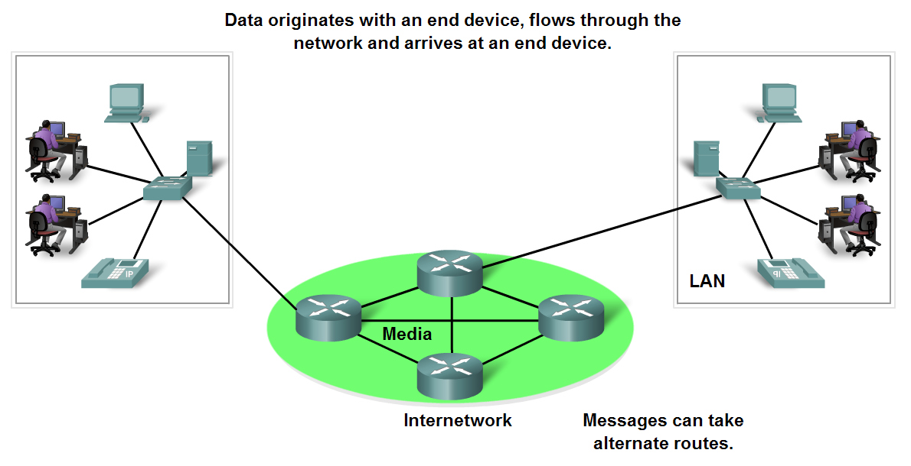
End Devices and their Role
End devices form interface with human network & communications network
‹#›

Slide 27
Intermediary devices
Provides connectivity between end devices.
Manages data as it flows through the network.
Examples?
Routers
Switches
‹#›

Slide 28
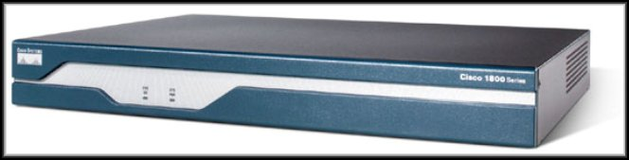
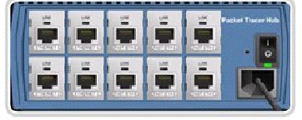
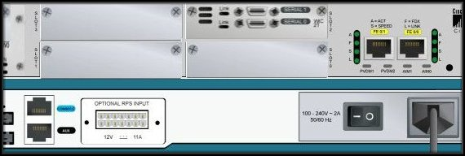
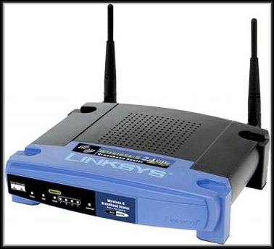

Intermediary devices
Hub
Router
Wireless Router
‹#›
Switch

Slide 29
Software
Services :
provides information in response to a request.
For example e-mail hosting services and web hosting services.
Processes :
Provide the functionality that directs and moves the messages through the network.
Processes are less obvious to us but are critical to the operation of networks.
‹#›

Slide 30
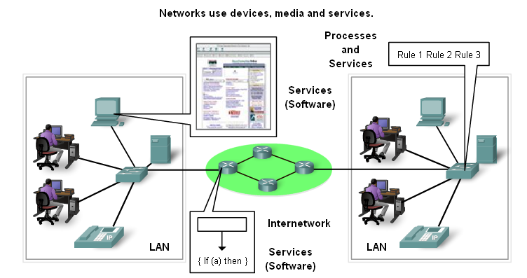
Processes and Services
‹#›

Slide 31
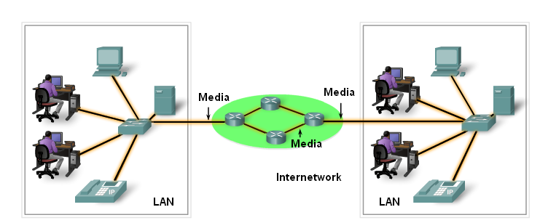
Media
‹#›

Slide 32
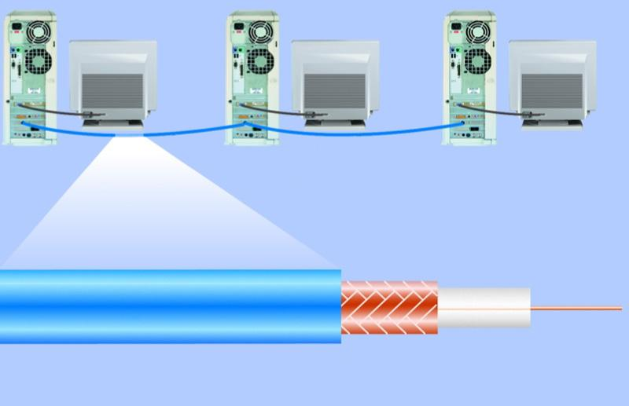
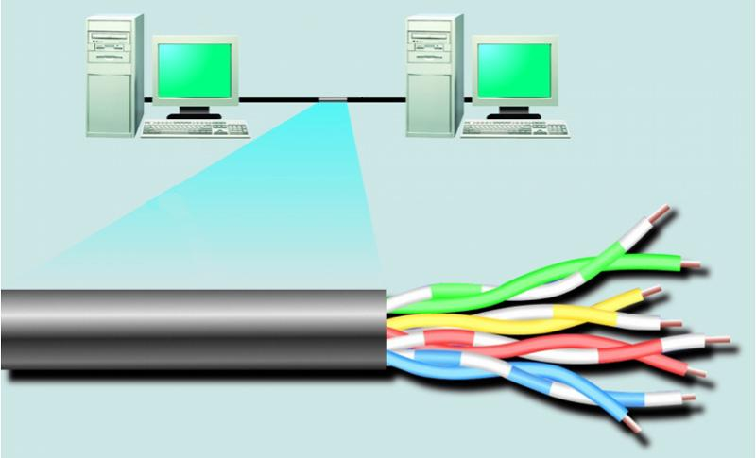
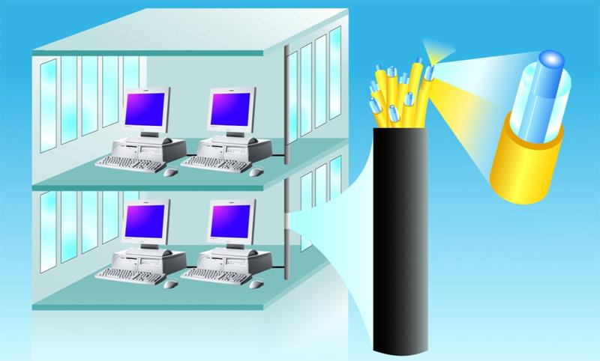
Network Media
woven or braided metal
twisted-pair cable
twisted-pair wire
copper wire
plastic outer coating
insulating material
optical fiber core
glass cladding
protective coating
‹#›

Slide 33
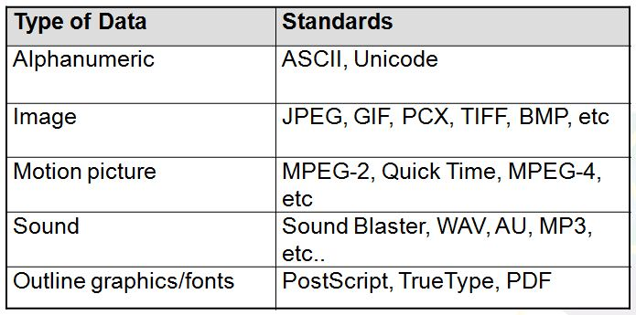
Messages- Data Representation
Information today comes in different forms such as
text, numbers, images, audio, and video.
‹#›

Slide 34
Data Representation-Text
Text : Different sets of bit patterns are designed to represent text symbols. Each set is called a code.
ASCII
American Standard Code for Information Interchange: 7-bit code/char, 1 bit for parity.
Unicode - 16 bit codes to represent a symbol.
‹#›

Slide 35
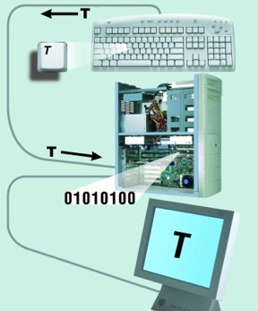
Data Representation-Text
‹#›

Slide 36
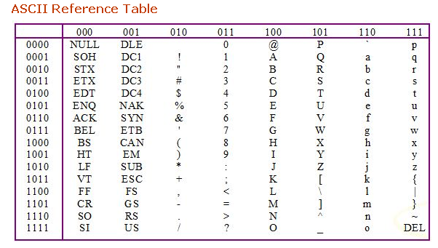
Text- Data Representation
‹#›

Slide 37
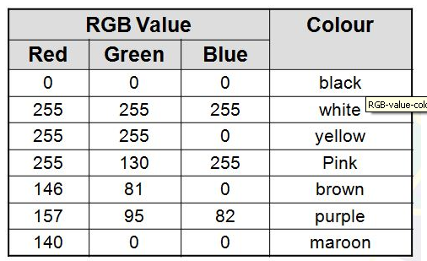
Data Representation
Images –
Also represented by bit patterns.
Mechanism different. Matrix of Pixels used. Each pixel is assigned to a bit pattern.
Color images uses RGB or YCM methods.
‹#›

Slide 38
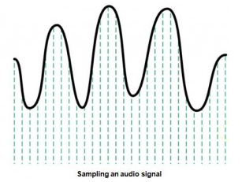
Data Representation
Audio- Continuous, not discrete. Converted to digital or analog signal.
‹#›

Slide 39
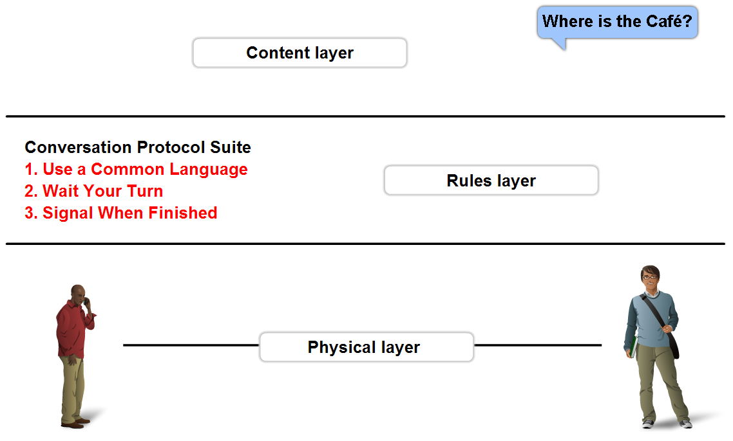
Rules - Protocols
A set of predetermined rules that govern communication.
Defines:
What is communicated??
How it is communicated??
When it is communicated??
‹#›

Slide 40
Network Types
PAN
LAN
MAN
WAN
‹#›

Slide 41
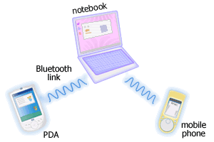
Personal Area Networks (PAN)
A network that connects computers, peripherals and other devices within a personal operating space.
Eg. Bluetooth
‹#›
http://www.conniq.com

Slide 42
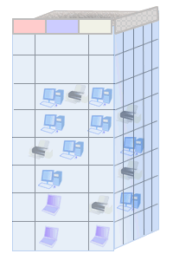
Local Area Networks (LAN)
Connects computers, peripherals and other devices within a building (e.g. office, home) or in a limited area.
Typical coverage 50 to 300 meters.
Ex. Ethernet, Wireless LANs
‹#›
http://www.conniq.com

Slide 43

Metropolitan Area Network (MAN)
Is a city wide network.
The coverage limitation is not strict, but real implementation may have range of up to 50 km in urban, suburban, or rural area.
Ex. WiMax
‹#›

Slide 44
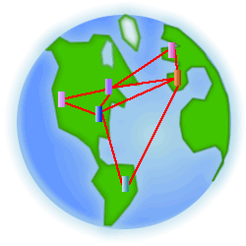
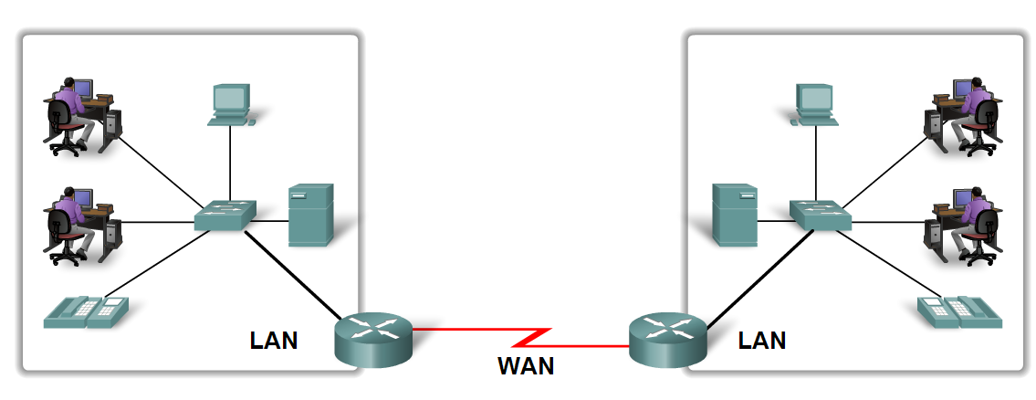
Wide Area Networks (WANs)
A network that spans larger geographical area.
LANs separated by geographic distance are connected by a Wide Area Network (WAN)
PSTN, Cellular Networks (GSM etc)
‹#›

Slide 45
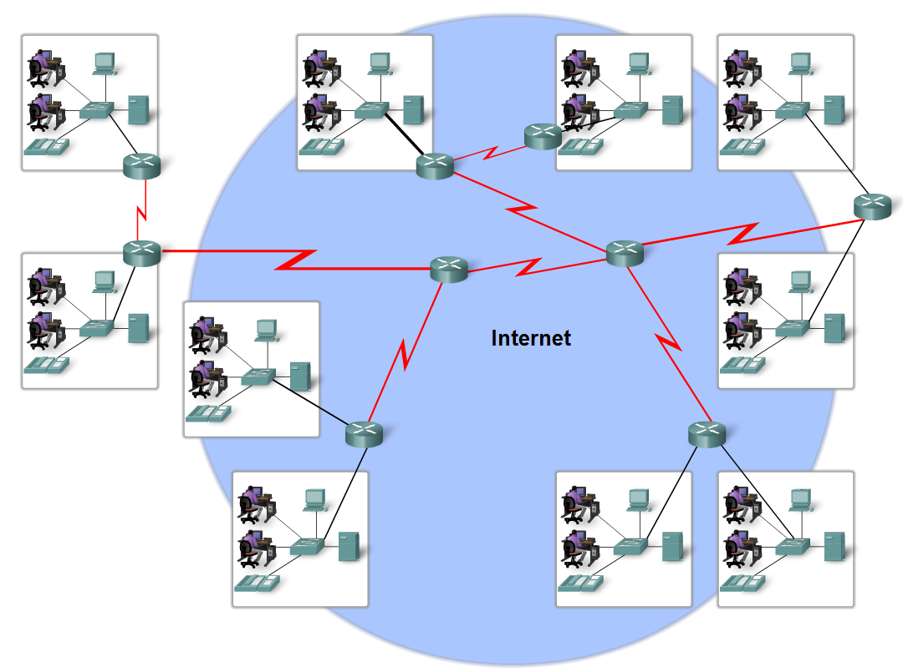
Internet
The internet is defined as a global mesh of interconnected networks.
‹#›

Slide 46
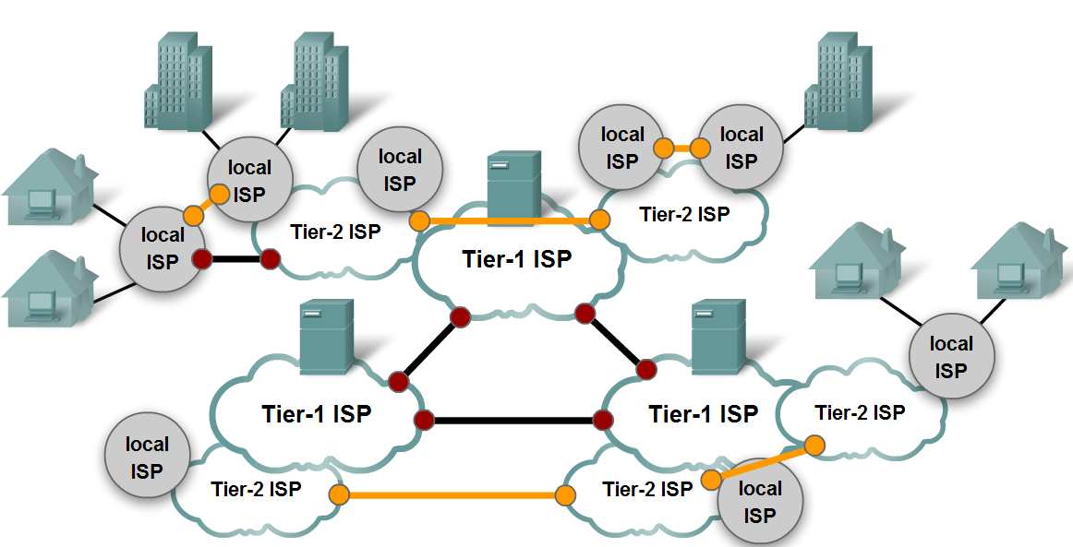
Internet
‹#›

Slide 47
Effectiveness of a system depends upon:
Delivery
Accuracy
Timeliness
Jitter

Slide 48
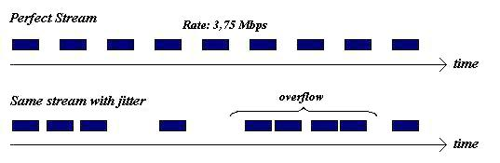

Slide 49
